Slide 1
2018
What is new this year?
Winner Prize Notifications, On-line Website resources, Adoption Packs, In-person selling, and more!

Slide 2
What hasn’t changed
On-line and “Paper” Duck Adoption Form sales will end at NOON at Bond Park, Visitor’s Center, and all downtown retailers.
Personal checks and cash are accepted for “paper” adoption forms. [$20 per Duck Adoption]
Please remind customers to select Your Organization on the back of the adoption form and circle its number for their donation to benefit your organization.
When selling a “paper” Duck Adoption ($20 each), be sure that the customer has filled out the front side of the form legibly with name/phone/email and to circle the number for your organization to receive the benefit of the sale ($19).

Slide 3
What has changed
New location for Duck Central
Ridgeline Hotel, Lake Estes room
See schedule on-line
New Website Launches today
https://www.EPDuckRace.org
Organizations’ Resources
Logos
New Adoption Form
First, Last, Email, Phone
Winners Notified by Email
Please ask Adopter (purchaser) to fill in the Email TWICE – much better chance of reading the hand written email address

Slide 4
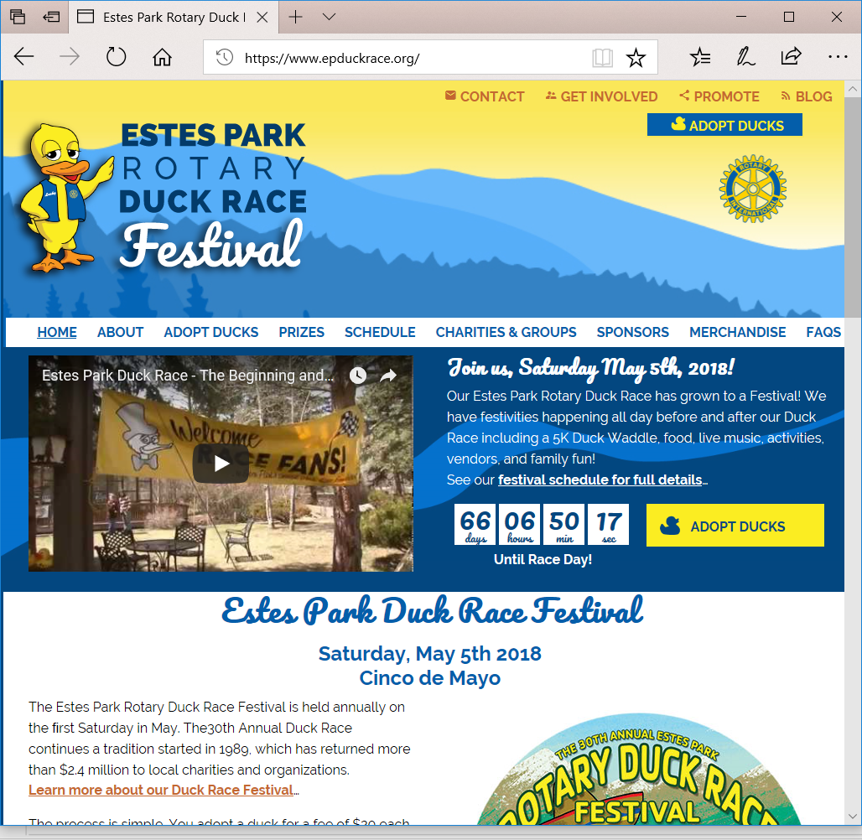
Narrow screen

Slide 5
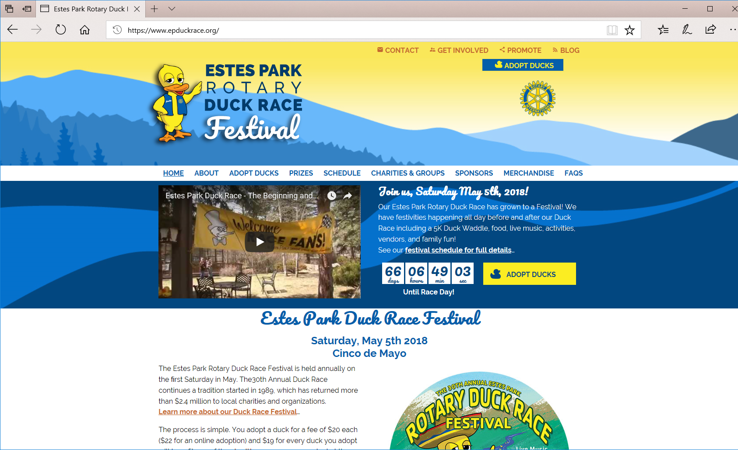
Wide Screen

Slide 6
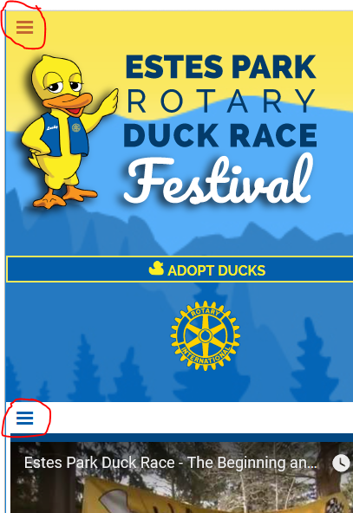
Mobile Responsive
Hamburger Menus

Slide 8
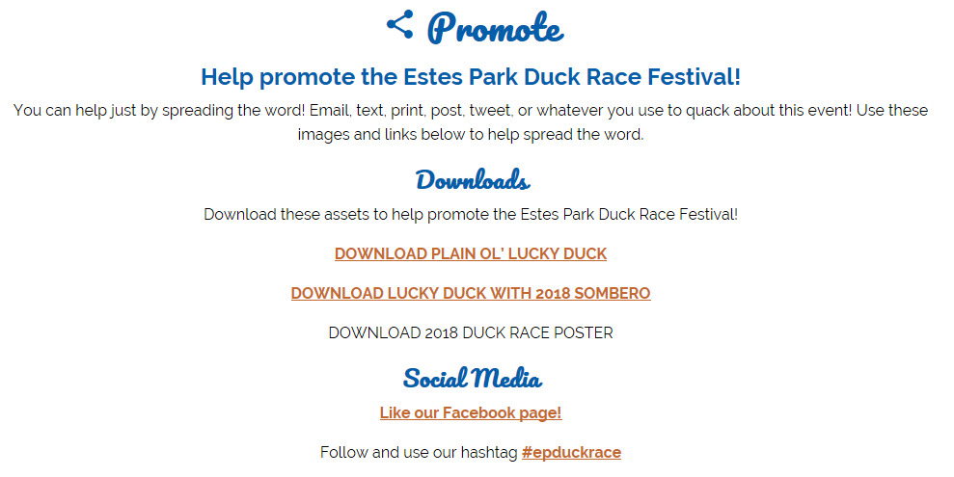
Organization Resources

Slide 9
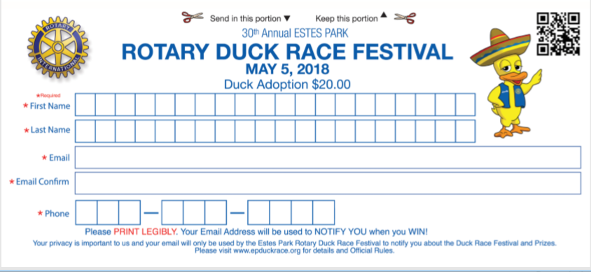

Slide 10
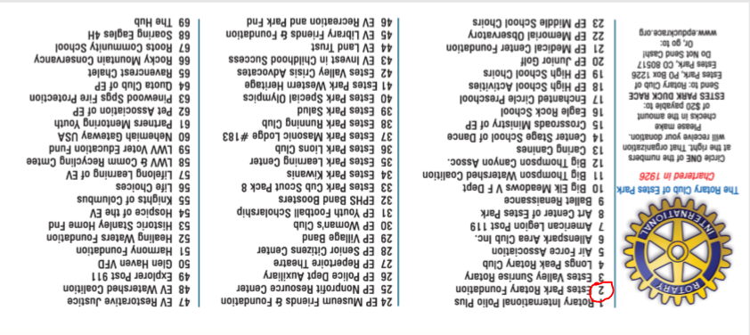

Slide 11
Eventbrite
Sell On-line
Sell In-person
Sell on Facebook

Slide 12
Duck Adoptions New Packs
Adoption 1 to 10 are $22 each
Quack Pack 3 for $62
Flock Pack 5 for $102
Paddling Pack 10 for $202

Slide 13
Why Adopt in Packs?
Great opportunity for your organization to ask for a 3, 5, or 10 pack donations! Your supporters will get more chances to win and your organization wins with greater financial support compared to single adoptions. Sell the packs and everyone wins!

Slide 14
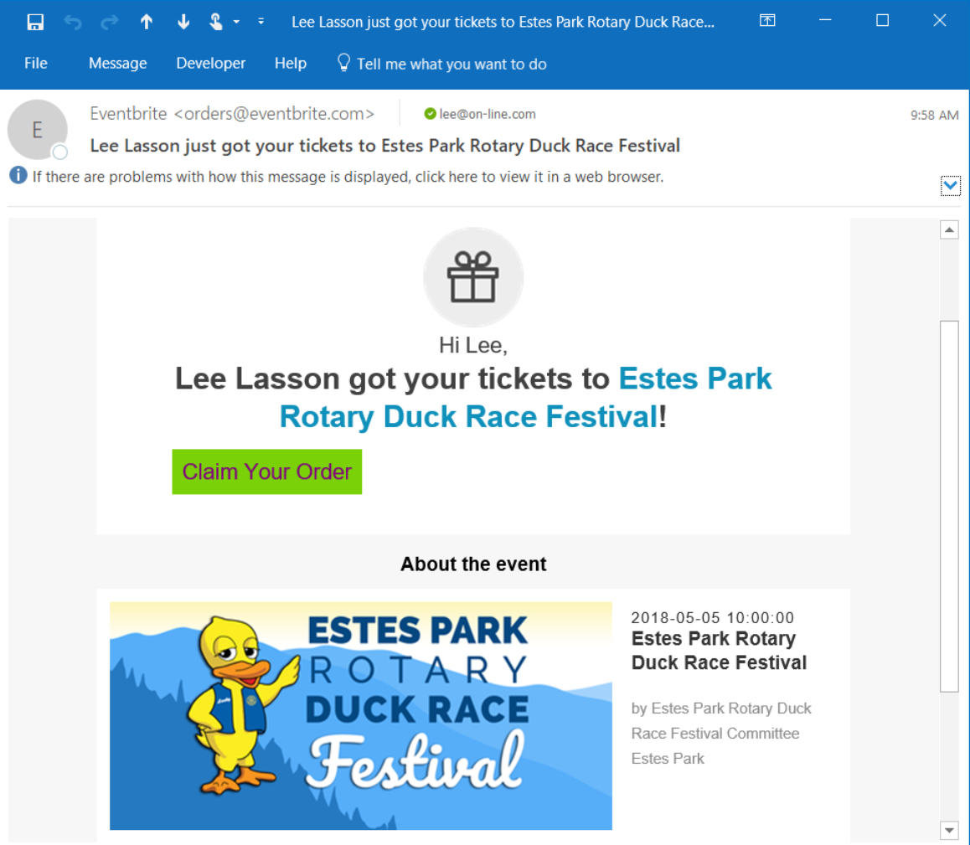

Slide 15
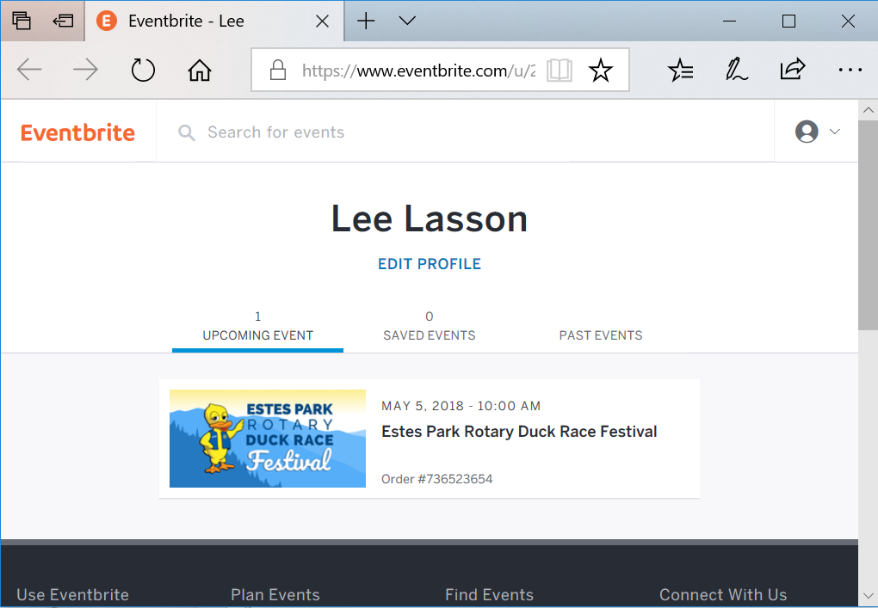

Slide 16
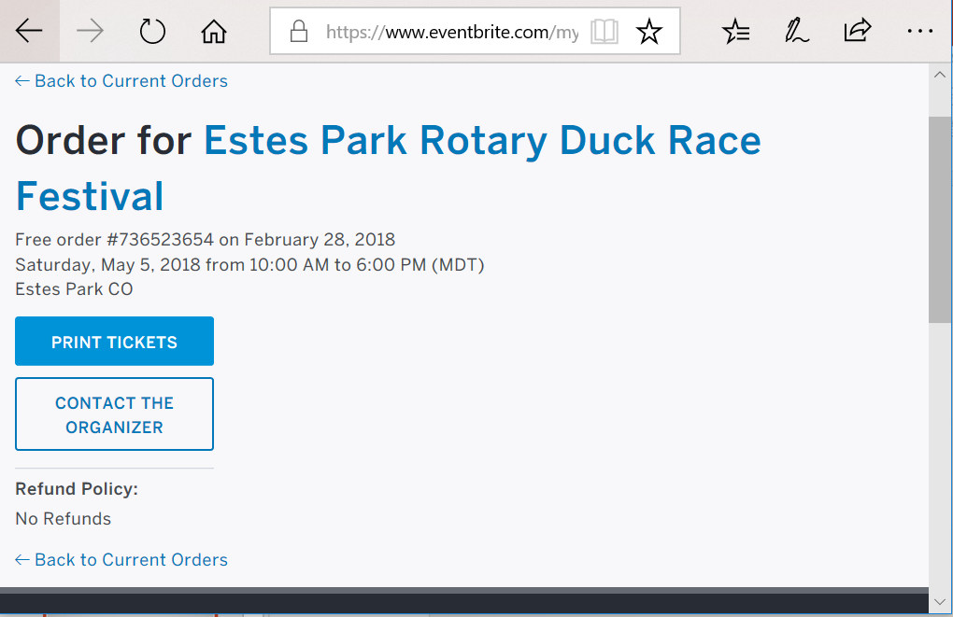

Slide 17
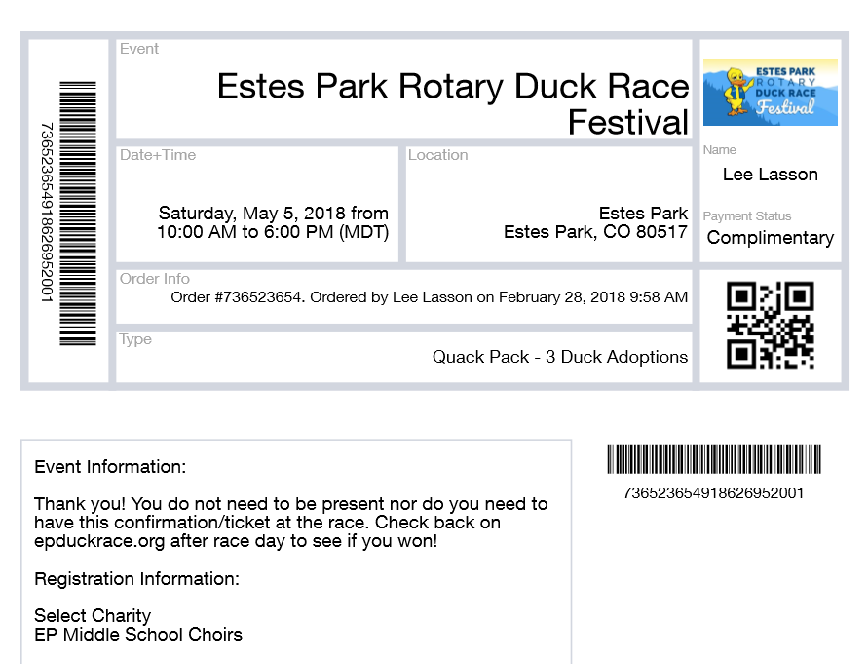

Slide 18
Sell in-person
Brand new this year – Sell In-person
Request Login (requires email address not previously used on Eventbrite)
iOS iPhone or iPad or Android Phone or Pad
Download and Install FREE Eventbrite Organizer App

Slide 19
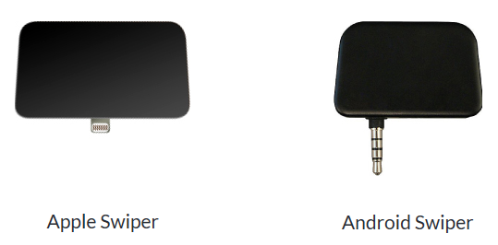
CARD READER
Optional hardware
Swipe Credit Cards to make a sale
https://eventbritestore.com/

Slide 20
Why Sell in-person?
You don’t have to have a Card Reader
Enter the payment information in the Eventbrite Organizer app.
Selling in-person saves your organization problems
NO Balancing money, checks, and forms!
Saves paper and the dog can’t eat it hopefully
Reduces re-entry labor by Duck Central and increases accuracy.

Slide 21
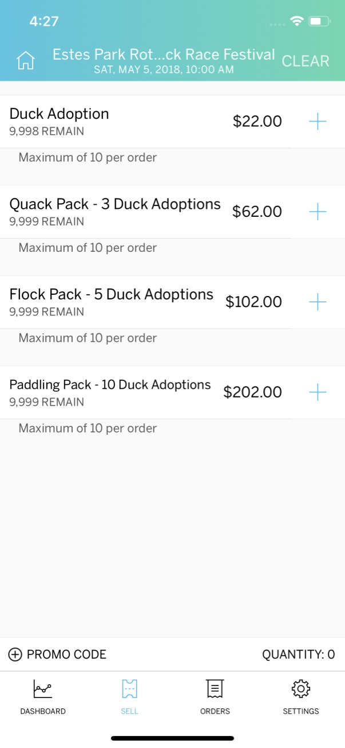

Slide 22
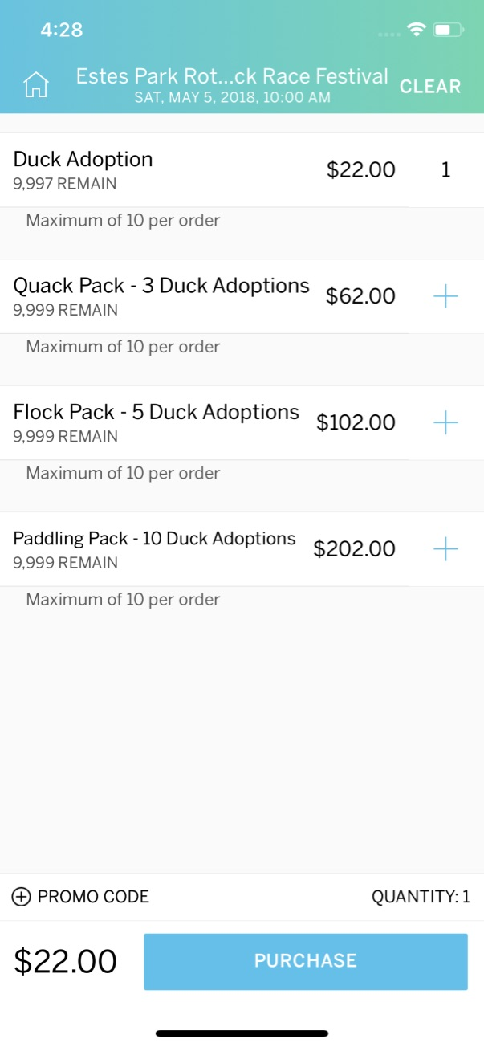

Slide 23
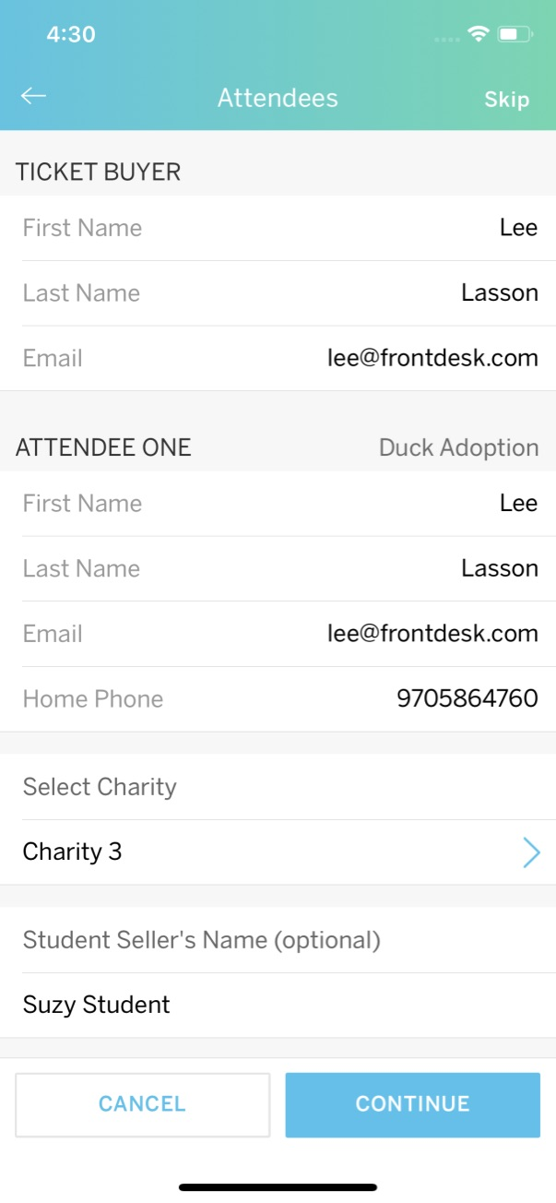

Slide 24
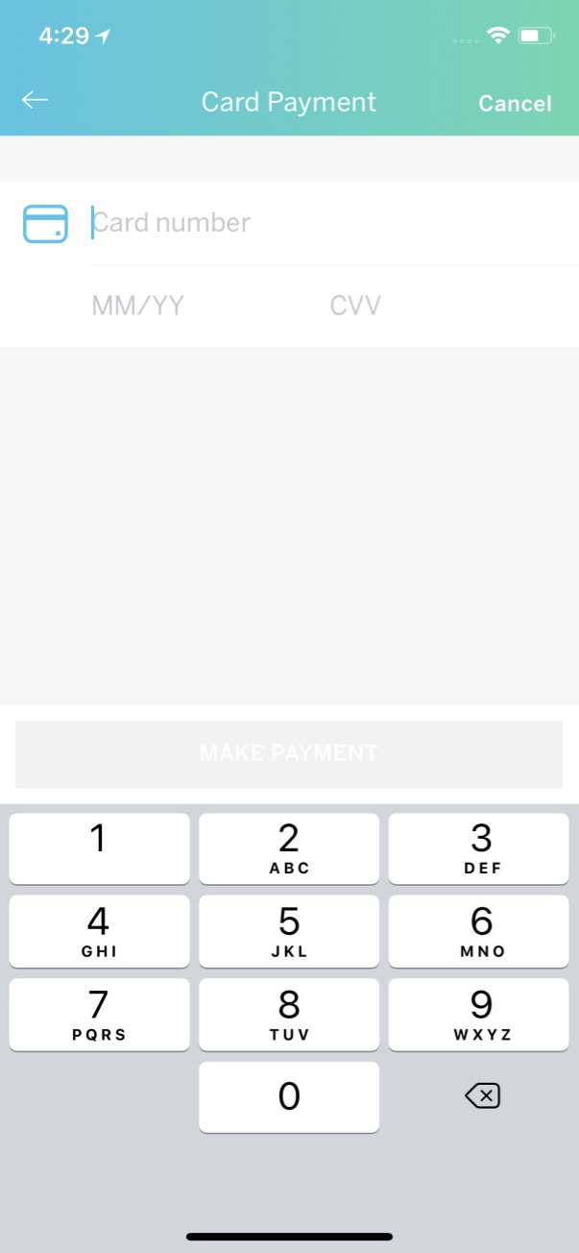

Slide 25
Questions?
Duck Central
DuckRace@RotaryClubOfEstesPark.org
Duck Central phone (970) 480-5002
Drop by Duck Central when staffed (approx. 70 hours pre-race) to ask questions
Get individualized training at Duck Central
Get Card Reader ($25 plus tax and shipping ~$27.75)
Get more Adoption Forms
Get buttons and Posters
Turn-in Adoption Forms

