Slide 1
2019
What is new for 2019?
On-line Website resources
In-person selling TIPS
and more!

Slide 2
What hasn’t changed
On-line and “Paper” Duck Adoption Form sales will end at NOON Nicky’s Steakhouse, Finish Line, Visitor’s Center, and all downtown retailers.
Personal checks and cash are accepted for “paper” adoption forms. [$20 per Duck Adoption]
Please remind customers to select Your Organization on the back of the adoption form and circle its number for their donation to benefit your organization.
When selling a “paper” Duck Adoption ($20 each), be sure that the customer has filled out the front side of the form legibly with name/phone/email and to circle the number for your organization to receive the benefit of the sale ($19).

Slide 3
What You Need TO KNOW
The location of Duck Central (the Duck Race Office)
Ridgeline Hotel, Lake Estes room
See schedule on-line
2019 Website Launches today
https://www.EPDuckRace.org
Organizations’ Resources
Logos

Slide 4
Adoption Form INFO
First, Last, Email, Phone
Please ask Adopter (purchaser) to fill in the Email TWICE – we have a much better chance of reading the hand written email address
Winners Notified by Email
The notification is proof of prize
Notification provides a Redemption Code to be shown to Merchant to claim prize
Merchants who donate prizes get a list of winners and Redemption Codes via email

Slide 5
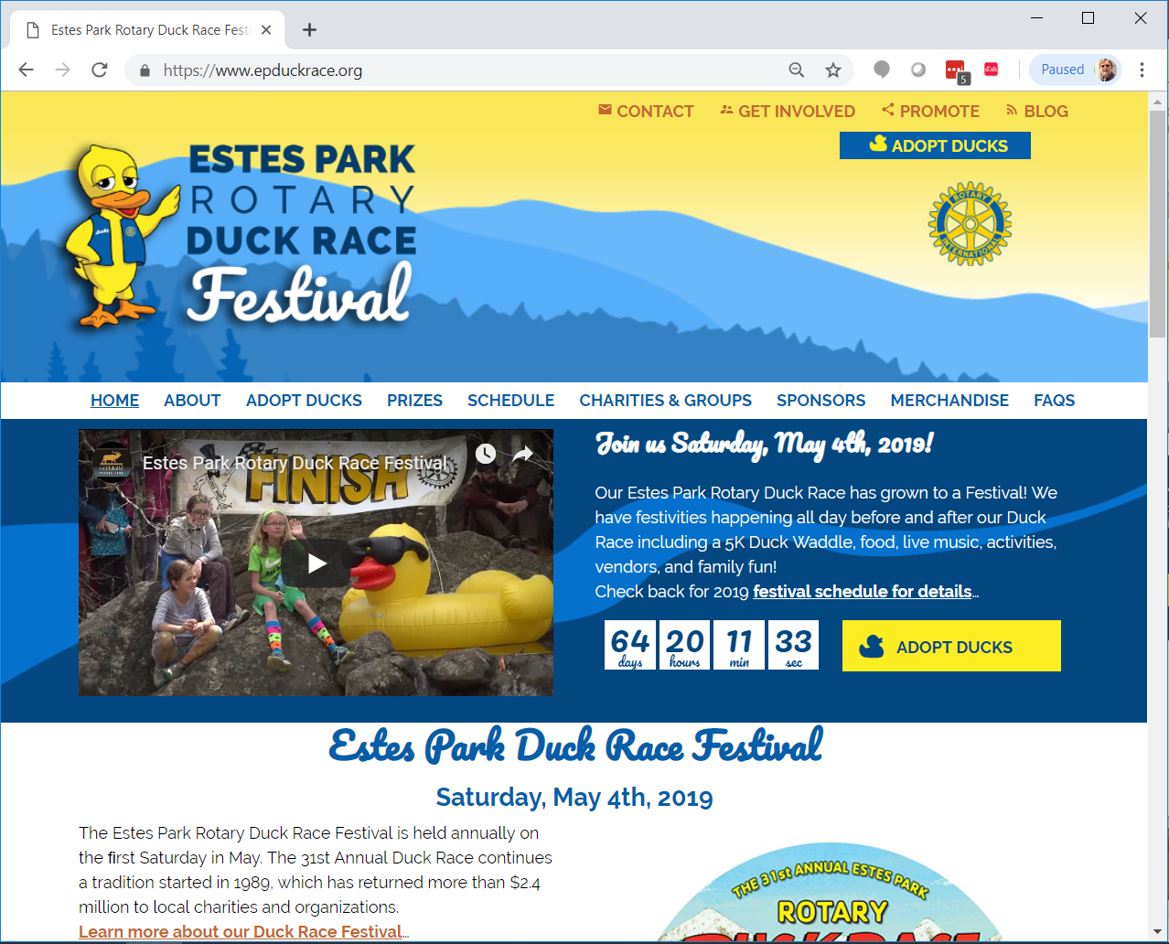
Narrow screen

Slide 6
Wide
Screen

Slide 7
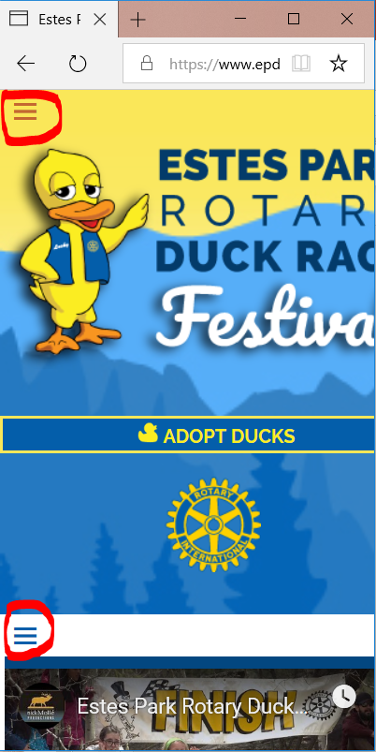
Mobile Responsive
Hamburger Menus

Slide 8
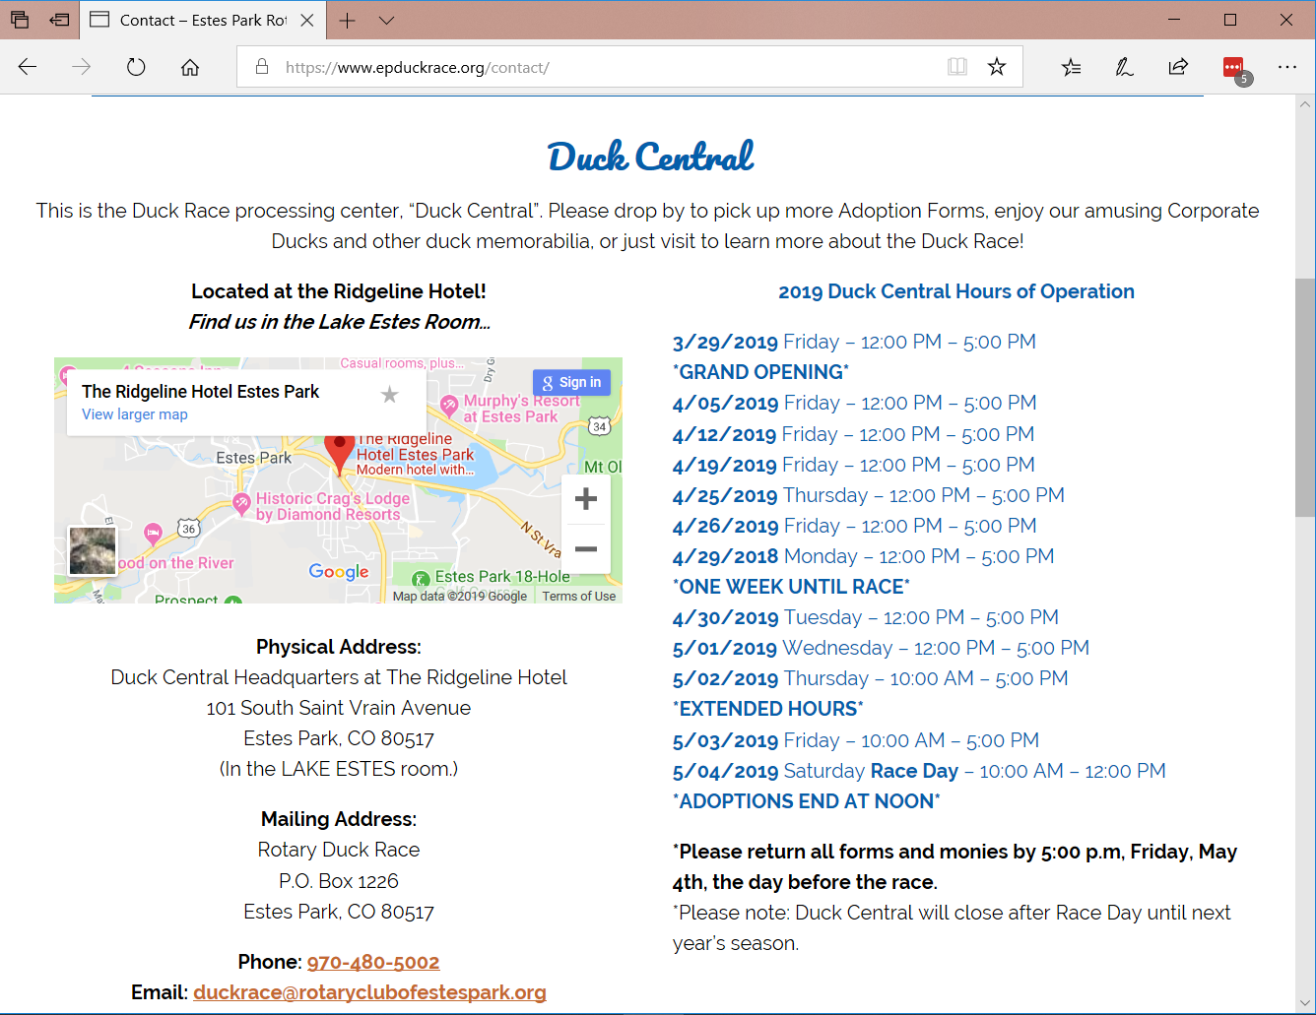

Slide 9
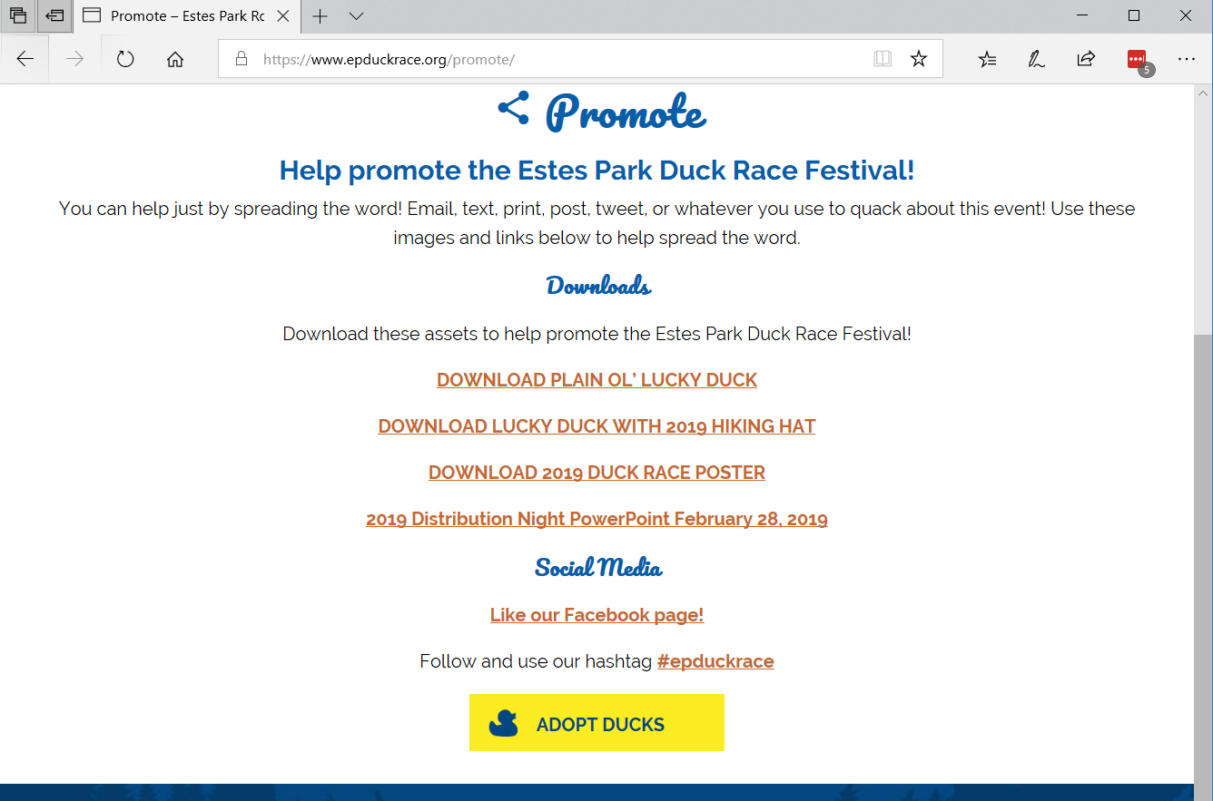
Organization Resources

Slide 10
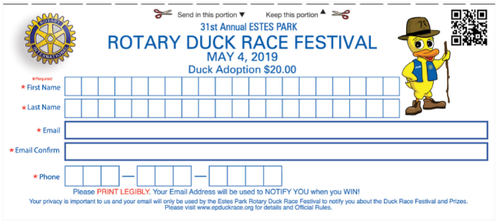

Slide 11
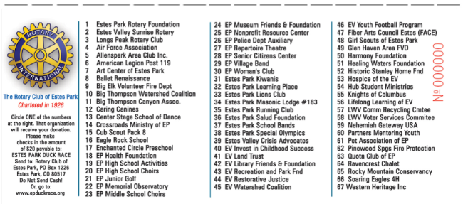

Slide 12
Eventbrite
Sell On-line
Sell In-person using mobile phone camera
Sell on Facebook

Slide 13
Duck Adoptions ON-LINE
Adoptions of 1 to 100 are $22 each
Each on-line adoption may benefit the same or different organizations on the same order.
Adoptions may be “gifted” to someone other than the buyer.

Slide 14
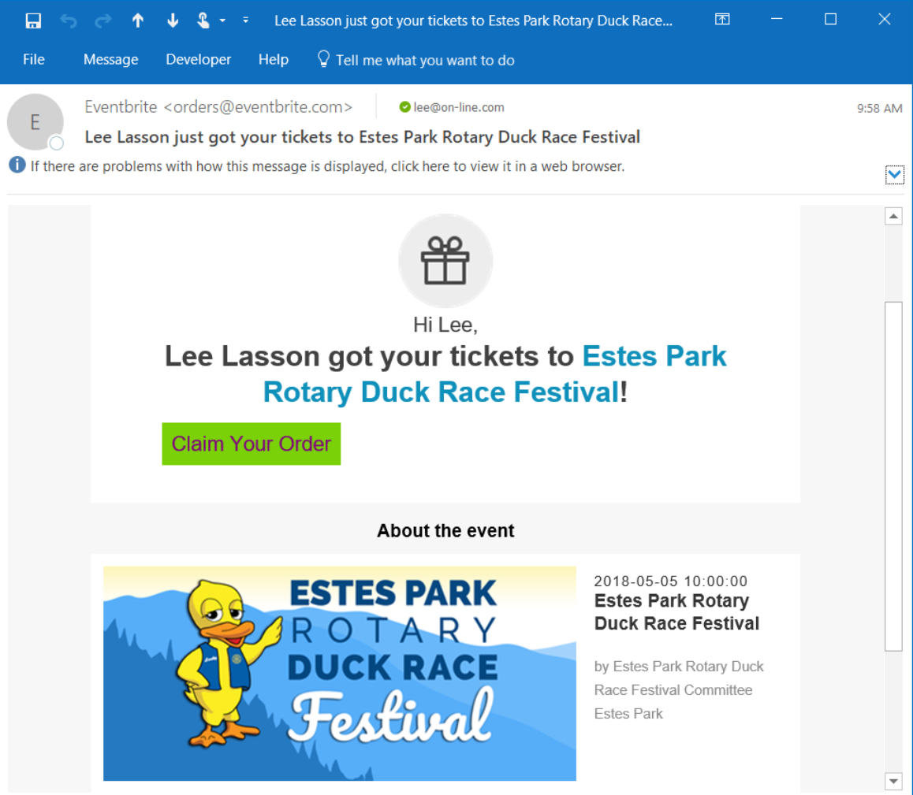

Slide 15
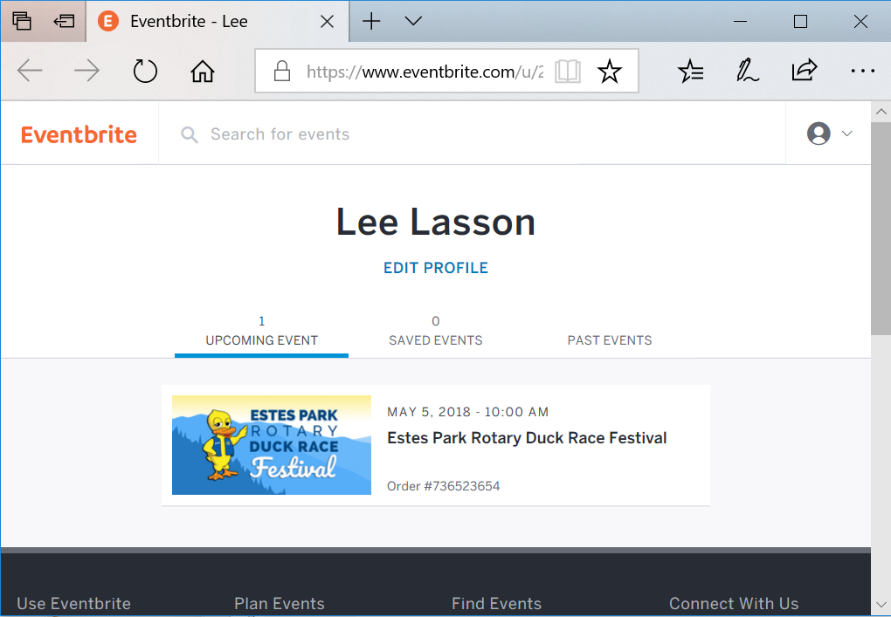

Slide 16
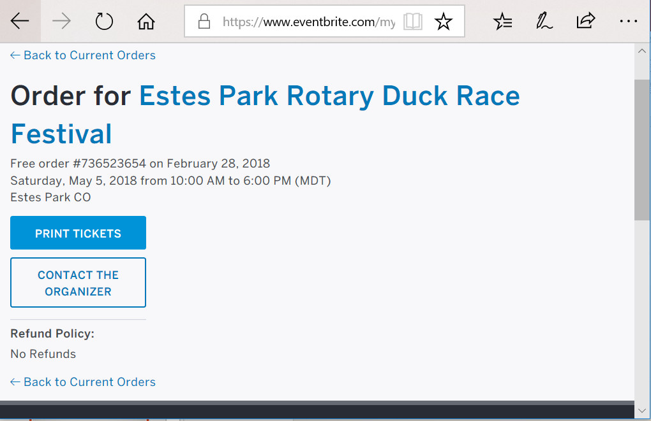

Slide 17
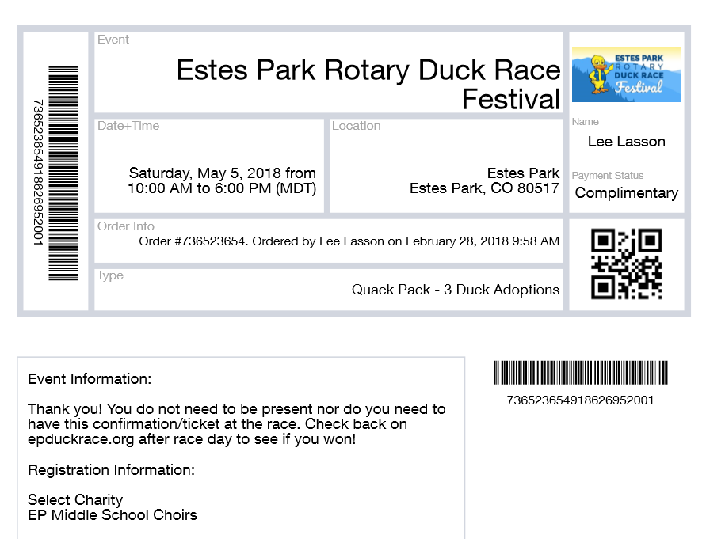

Slide 18
Sell in-person
iOS iPhone or iPad
Android Phone or Pad
Camera can be used to enter the credit card number and expiration date. Much easier than trying to type 16 digits correctly!

Slide 19
Why Sell in-person?
Selling in-person saves your organization problems
NO Balancing money, checks, and forms!
Saves paper and the dog can’t eat the adoptions forms, hopefully!
Reduces re-entry labor by Duck Central and increases accuracy.

Slide 20
Questions?
Duck Central
DuckRace@RotaryClubOfEstesPark.org
Duck Central phone when staffed (approx. 70 hours pre-race) (970) 480-5002
Drop by Duck Central to ask questions
Get individualized training at Duck Central
Get more Adoption Forms
Get buttons and Posters
Turn-in Adoption Forms

