Slide 1
2020
What is new for 2020?
On-line Website resources
In-person selling TIPS
and more!

Slide 2
Lucky has a new hat!

Slide 3
What hasn’t changed
“Paper” Duck Adoption Form sales will end at NOON Nicky’s Steakhouse, Finish Line, Visitor’s Center, and all downtown retailers.
Personal checks and cash are accepted for “paper” adoption forms. [$20 per Duck Adoption]
Please remind customers to select Your Organization on the back of the adoption form and circle its number for their donation to benefit your organization.
When selling a “paper” Duck Adoption ($20 each), be sure that the customer has filled out the front side of the form legibly with name/phone/email and to circle the number for your organization to receive the benefit of the sale ($19).

Slide 4
On-line Adoption SALES
But this changed!
Stop at 12:30 PM Saturday 5/2/2020
This means your organization can continue to sell using the on-line website 30 minutes later than paper sales close!

Slide 5
What YOU NEED TO KNOW
The location for Duck Central
Ridgeline Hotel, Lake Estes room
See schedule on-line
Website Adoptions start tomorrow (midnight tonight)
https://www.EPDuckRace.org
Organizations’ Resources
Duck Images
Hatless Lucky (good for multiple years)
2020 Luck with a stylish hat
Ready to go to a derby
And you can find a copy of this presentation
And the Duck Race poster is there to download

Slide 6
Adoption Form INFO
First, Last, Email, Phone
Please ask Adopter (purchaser) to fill in the Email TWICE – we have a much better chance of reading the handwritten email address
Winners Notified by Email
The notification is proof of prize
Notification provides a Redemption Code to be shown to Merchant to claim prize
Merchants who donate prizes get a list of winners and Redemption Codes via email

Slide 7
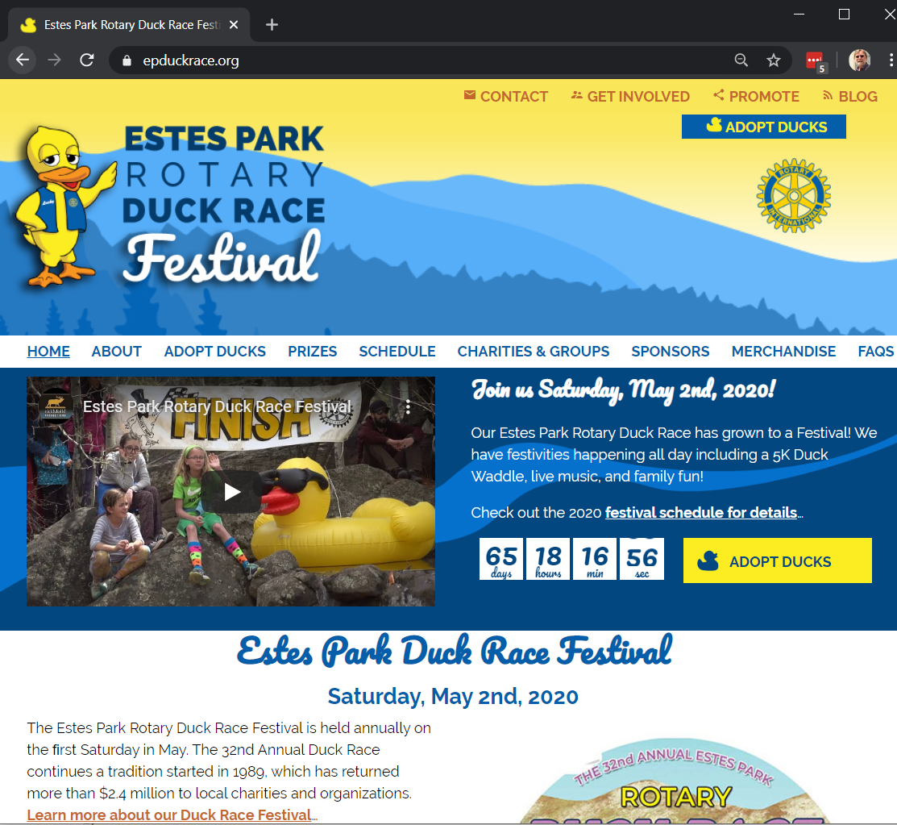
Narrow screen

Slide 8
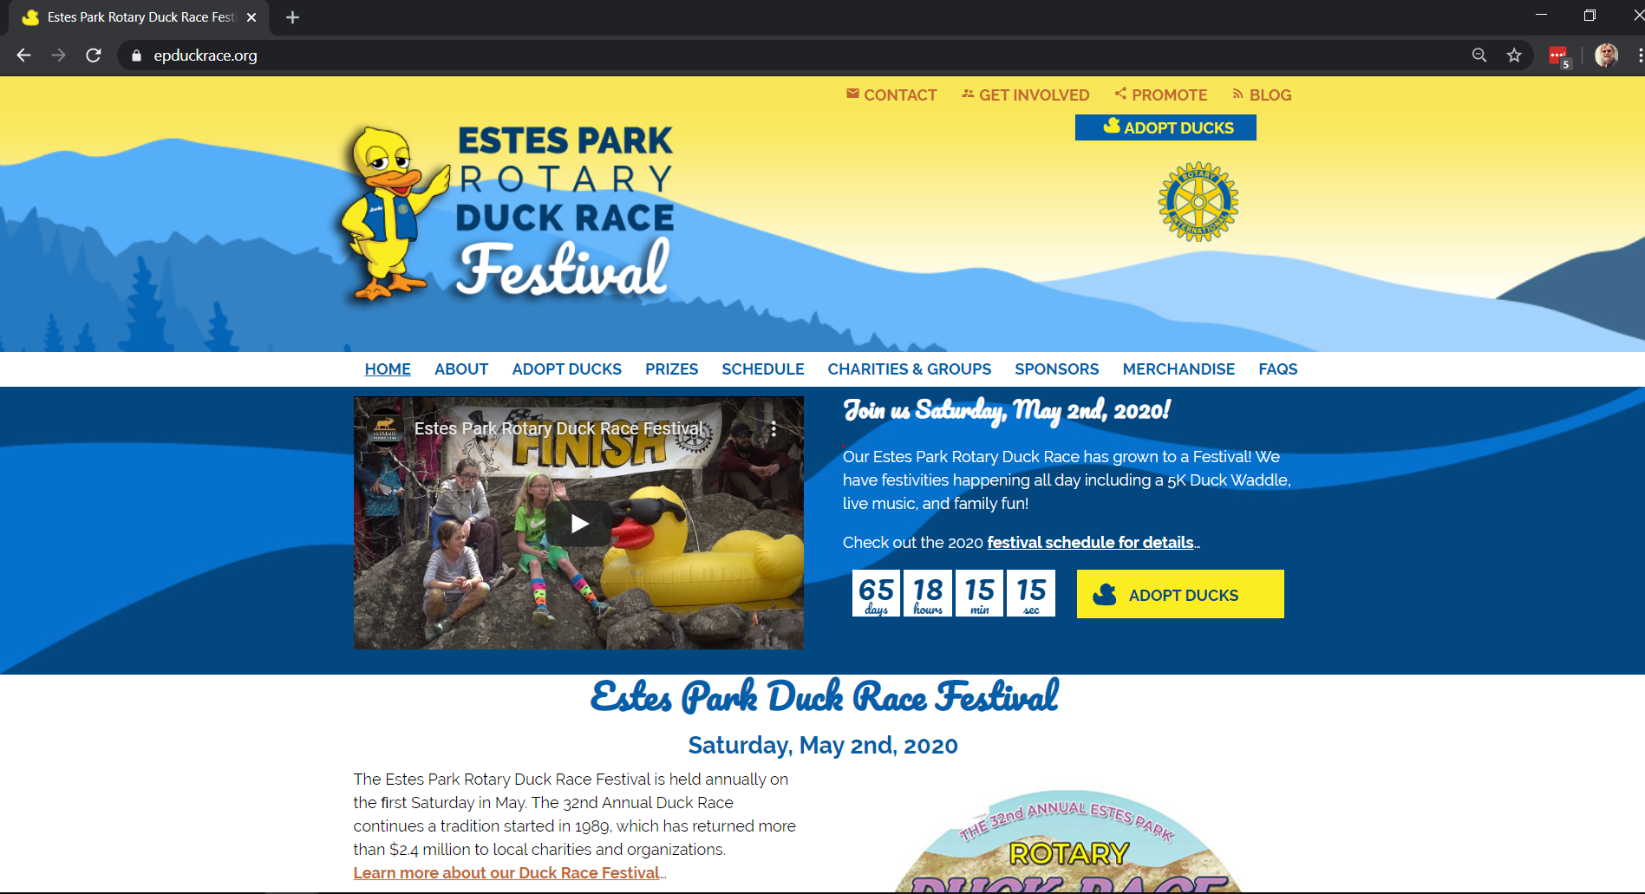
WIDE SCREEN

Slide 9
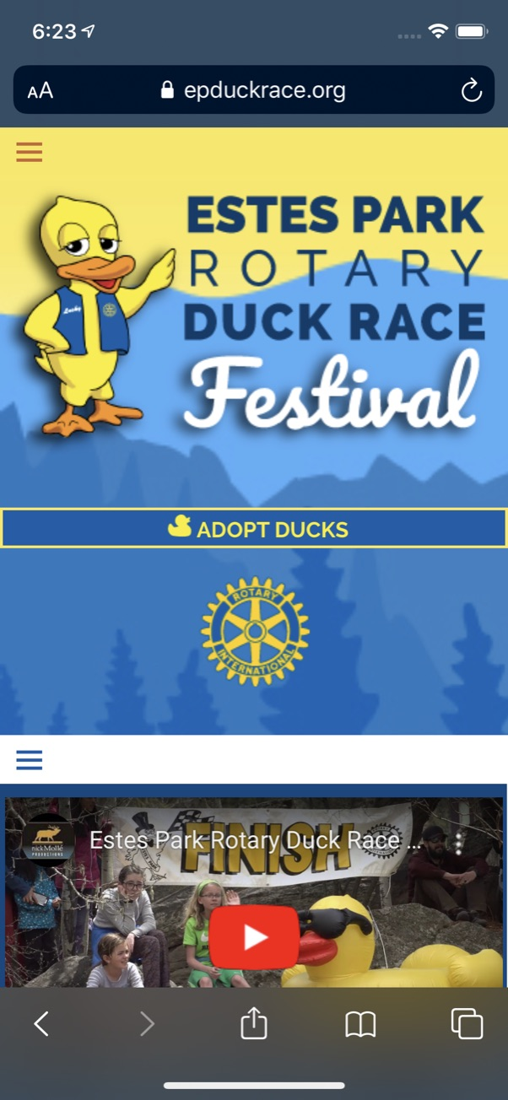
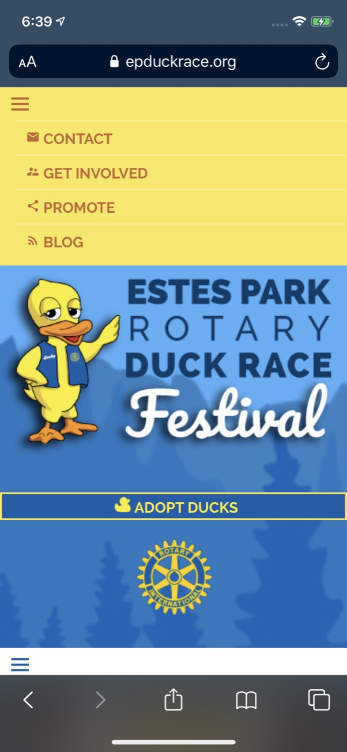
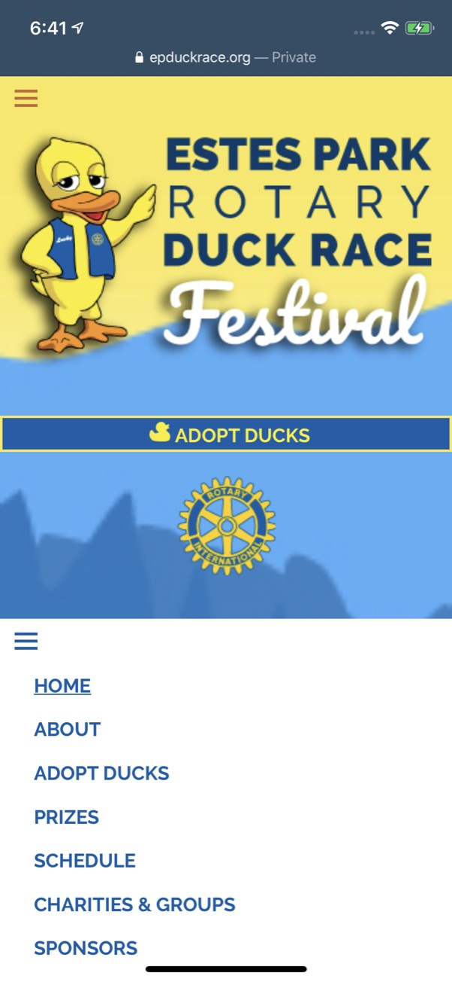
Hamburger Menus
Mobile Responsive

Slide 11
Organization Resources

Slide 12
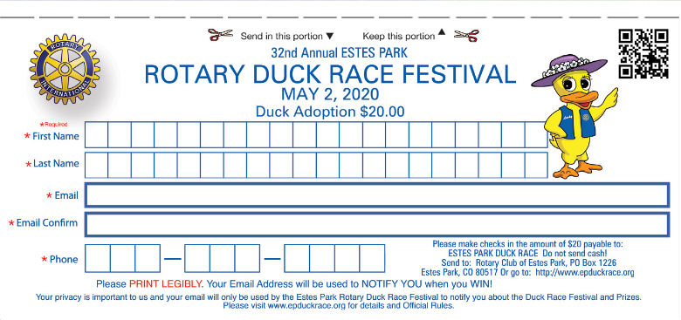

Slide 13
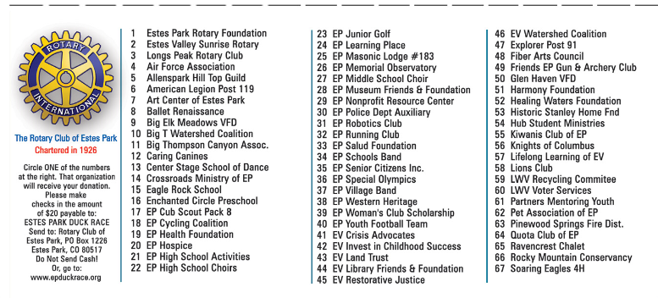

Slide 14
Eventbrite
Sell On-line
Sell In-person using mobile phone camera
Sell on Facebook

Slide 15
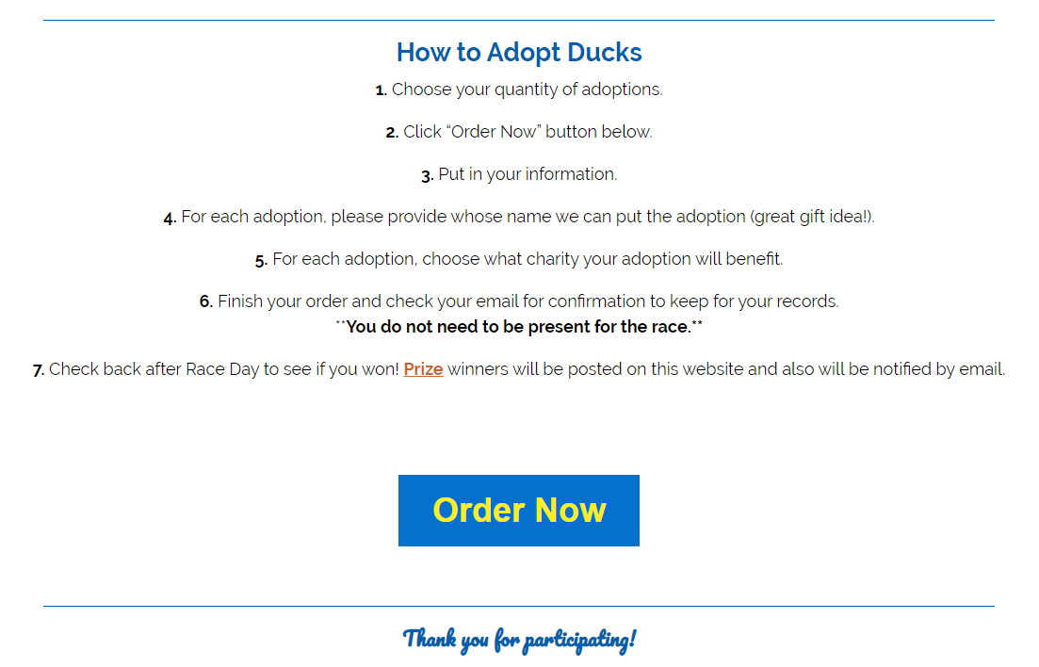
On-line purchase flow

Slide 16
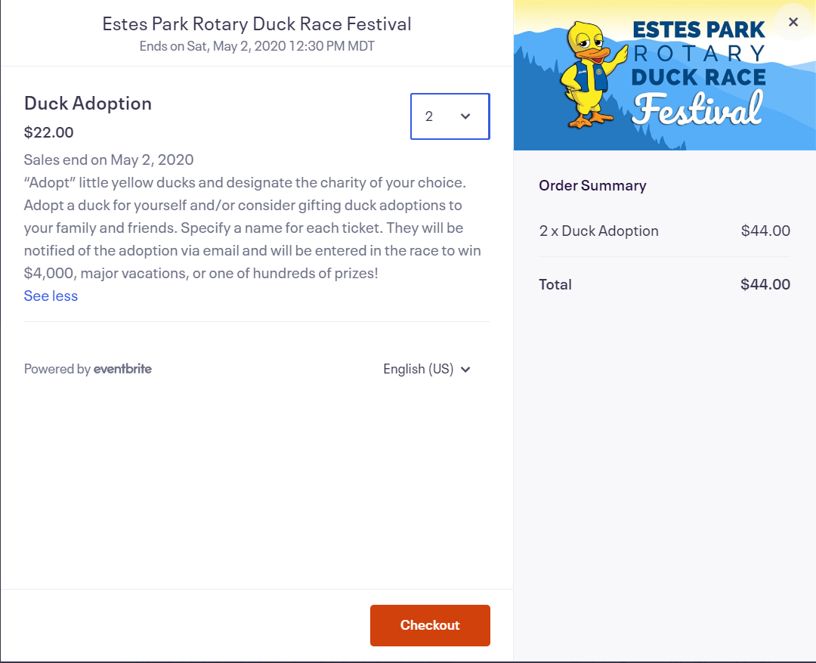

Slide 17
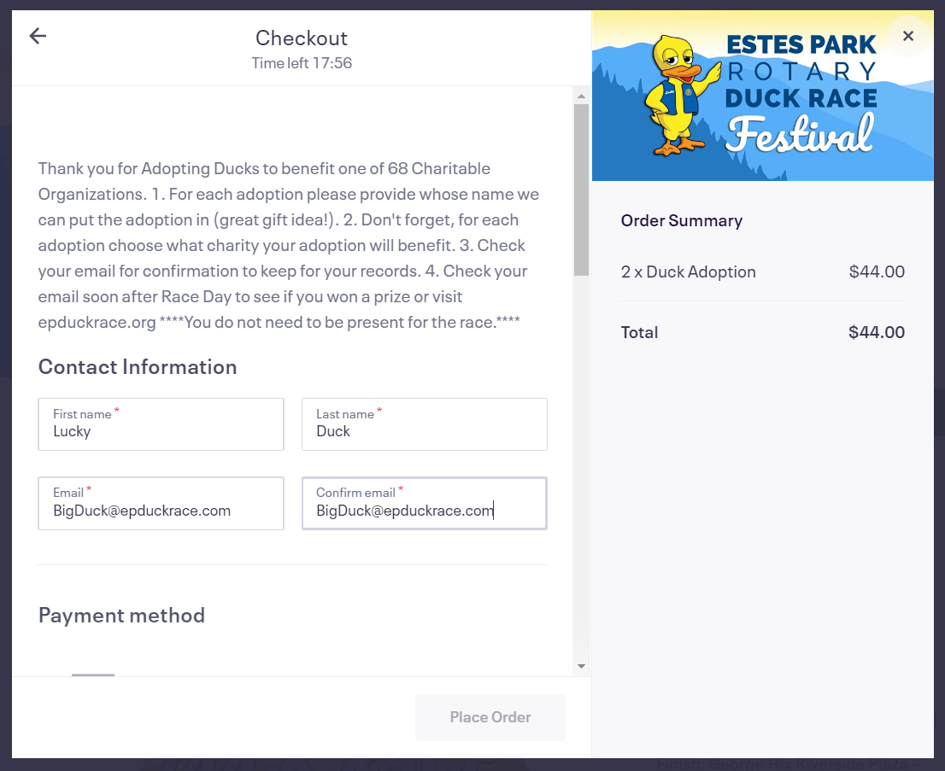
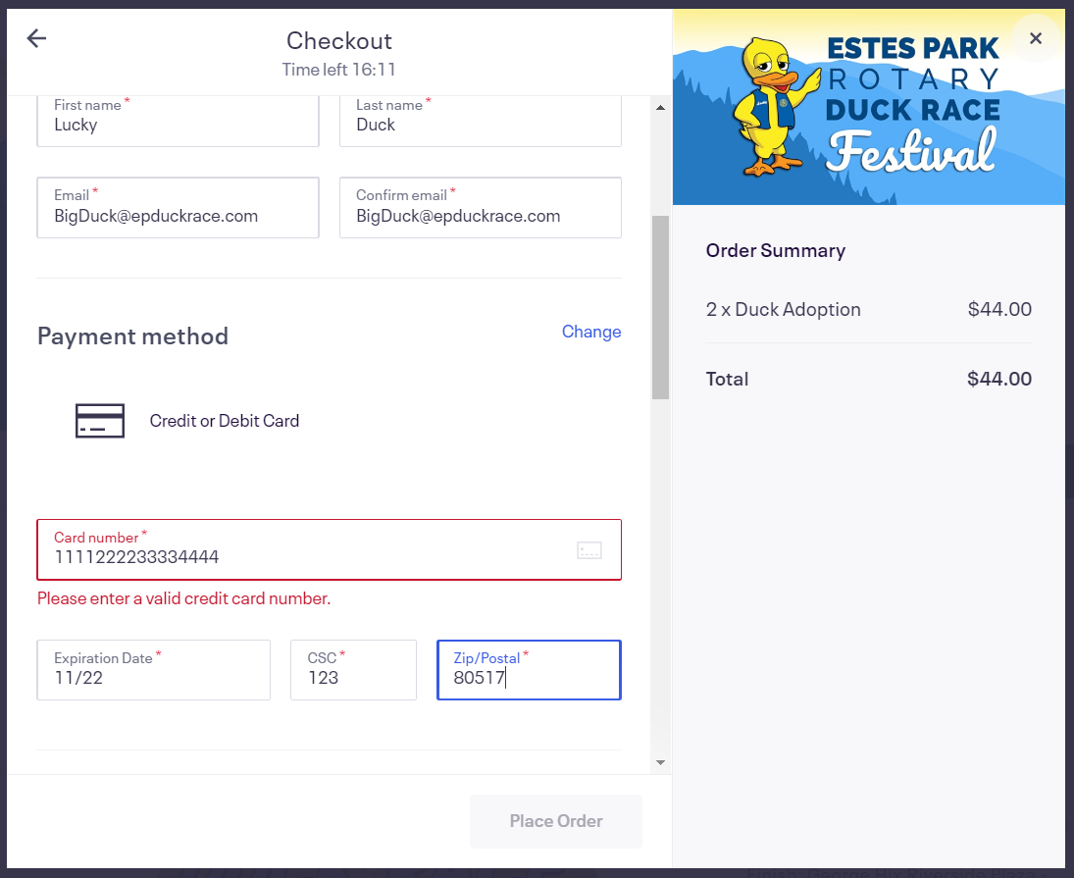

Slide 18
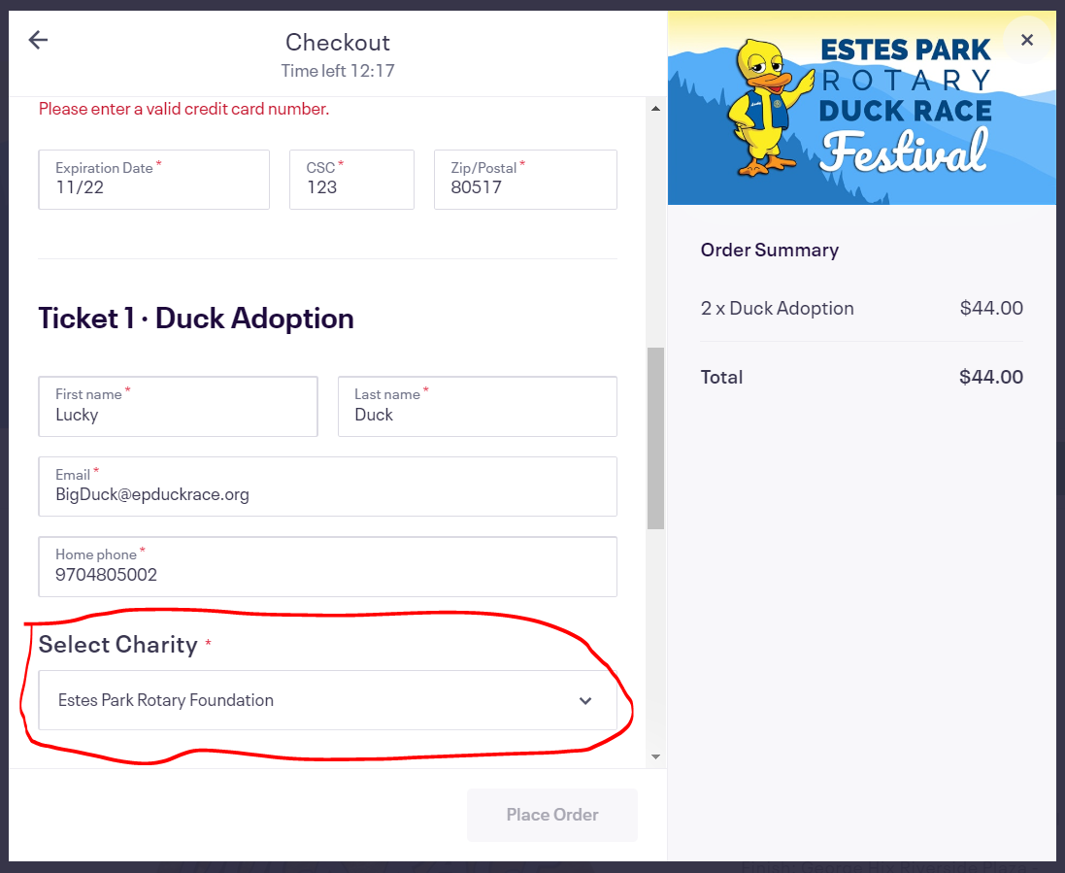

Slide 19
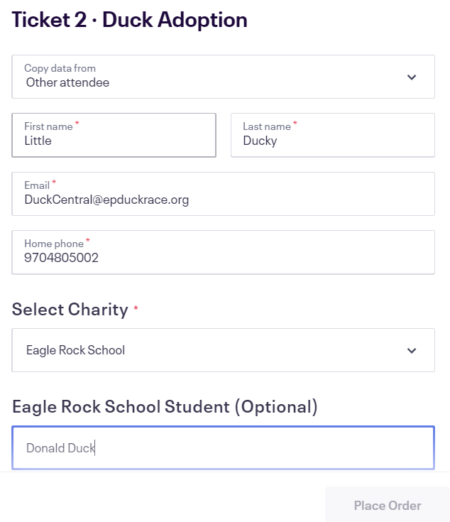

Slide 20
Custom FIELD QUESTIONs Do you need this?
Ballet Renaissance Student (Optional)
Center Stage School of Dance Student (Optional)
Eagle Rock School Student (Optional)
EP High School Activities Student (Optional)
EP High School Choirs Student (Optional)
EP Junior Golf Student (Optional)
EP Middle School Choir Student (Optional)
EP Schools Bands Student (Optional)
Hub Student Ministries Student (Optional)
Ravencrest Chalet Student (Optional)
Soaring Eagles 4H Student (Optional)

Slide 21
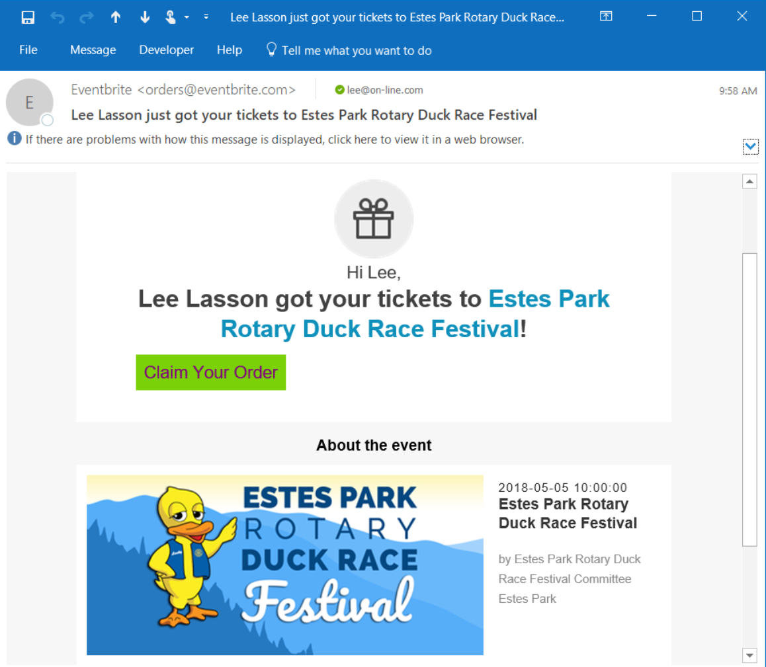

Slide 22
Sell in-person
Order using EPDuckRace.org
On an iOS iPhone or iPad with camera
On an Android Phone or Pad with camera
Camera can be used to enter the credit card number and expiration date. Much easier than trying to type 16 digits correctly! It is a feature on most cameras.
Simply hold the Credit Card up to the camera and it will auto fill card information.

Slide 23
Why Sell in-person?
Selling in-person saves your organization problems
NO Balancing money, checks, and forms!
Saves paper and the dog can’t eat the adoption forms hopefully!
Reduces re-entry labor by Duck Central and increases accuracy.
And you can sell Adoptions up to 12:30 PM on Race Day later than anyone selling paper forms.

Slide 24
Questions?
Duck Central
DuckCentral@EPDuckRace.org
Duck Central phone (970) 480-5002
Drop by Duck Central when staffed (approx. 66 hours pre-race) to ask questions
Get individualized training at Duck Central
Get more Adoption Forms
Get buttons and Posters
Get Turn-In Worksheets
Turn-in Adoption Forms

