Slide 1
2021 Estes Park Rotary Duck Race Kick-Off
How the race is RUN!

Slide 2
Introductions 2021 Big Duck Bill Solms
Welcome all 2021 Organizations!
Duck Race Committee
Special Guest who has something to Proclaim!

Slide 3
Town of Estes Park MAYOR WENDY KOENIG
970-577-3706
wkoenig@estes.org

Slide 4
2021
What in the duck world has changed?

Slide 5
Lucky has a new hat!

Slide 7
What ELSE has changed?
NO “Paper” Duck Adoption Forms
All Adoptions are On-line
On-line Streaming Live Event!
Adoptions are $22 each
Or a Quack Pack
Adopt 5 and get a 6th Duck in the Race - Only $110

Slide 8
On-line Adoption SALES
And this changed!
Adoption sales Stop at 1:00 PM Saturday 5/1/2021!

Slide 9
What YOU NEED TO KNOW
Duck Central
No Duck Central office for 2021
Email: DuckCentral@EPDuckRace.org or call (970) 235-1721
Website Adoptions started tonight 6:00 PM
https://www.EPDuckRace.org
Organizations’ Resources
Duck Images
Hatless Lucky (good for multiple years)
2021 Lucky with a firefighter themed hat
And you can find a copy of this presentation
And the Duck Race poster is there to download
Get Lucky and post away!

Slide 10
Adoption Form INFO
Each Adoption Requires First, Last, Email, Phone
Buyers may “Gift” Adoptions to family and friends
Winners Notified by Email
The notification is proof of prize
Notification provides a Redemption Code to be shown to Merchant to claim prize
Merchants who donate prizes get a list of winners and Redemption Codes via email
Winners listed on EPDuckRace.org after 5:00 PM Race Day

Slide 11
Narrow screen

Slide 12
WIDE SCREEN

Slide 13
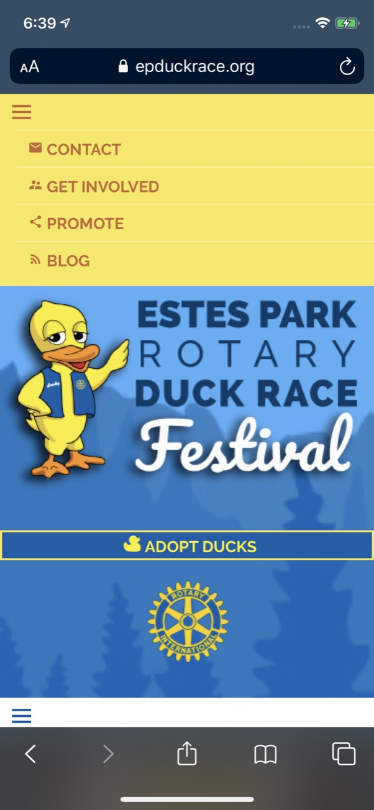
Hamburger Menus
Mobile Responsive

Slide 14
Organization Resources

Slide 15
Eventbrite
Sell On-line
Sell In-person using mobile phone camera
Sell on Facebook by linking to
EPDuckRace.org/adopt-ducks

Slide 16
On-line purchase flow

Slide 17
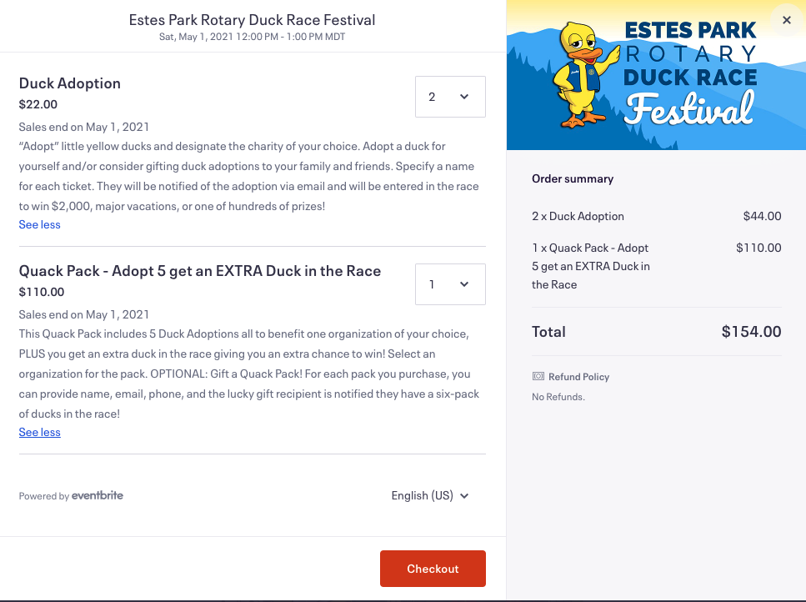

Slide 18
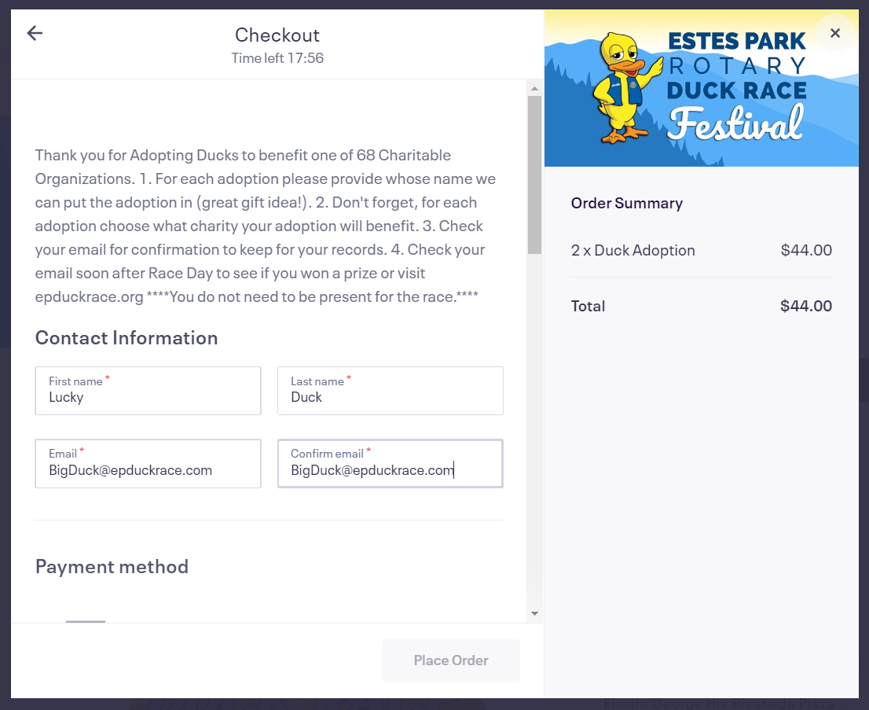
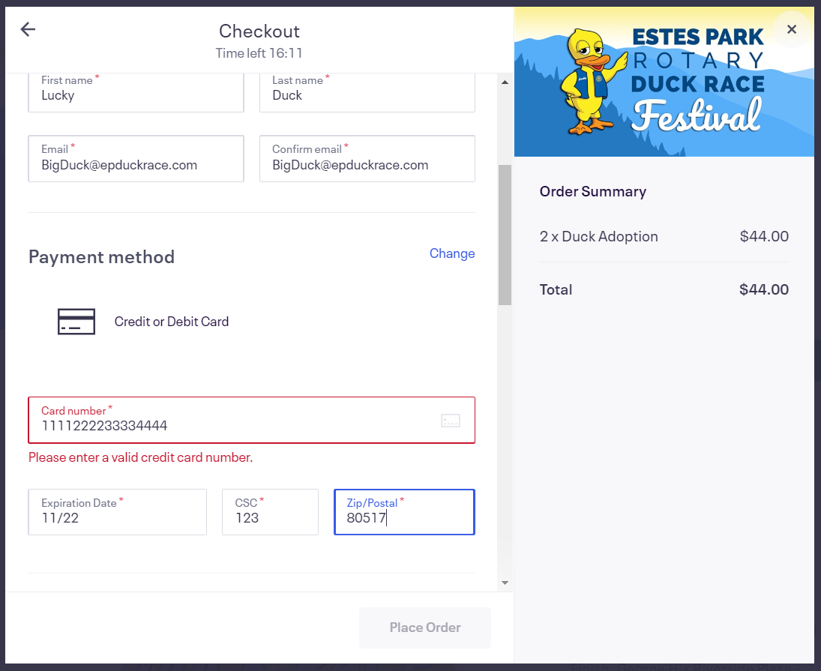

Slide 19
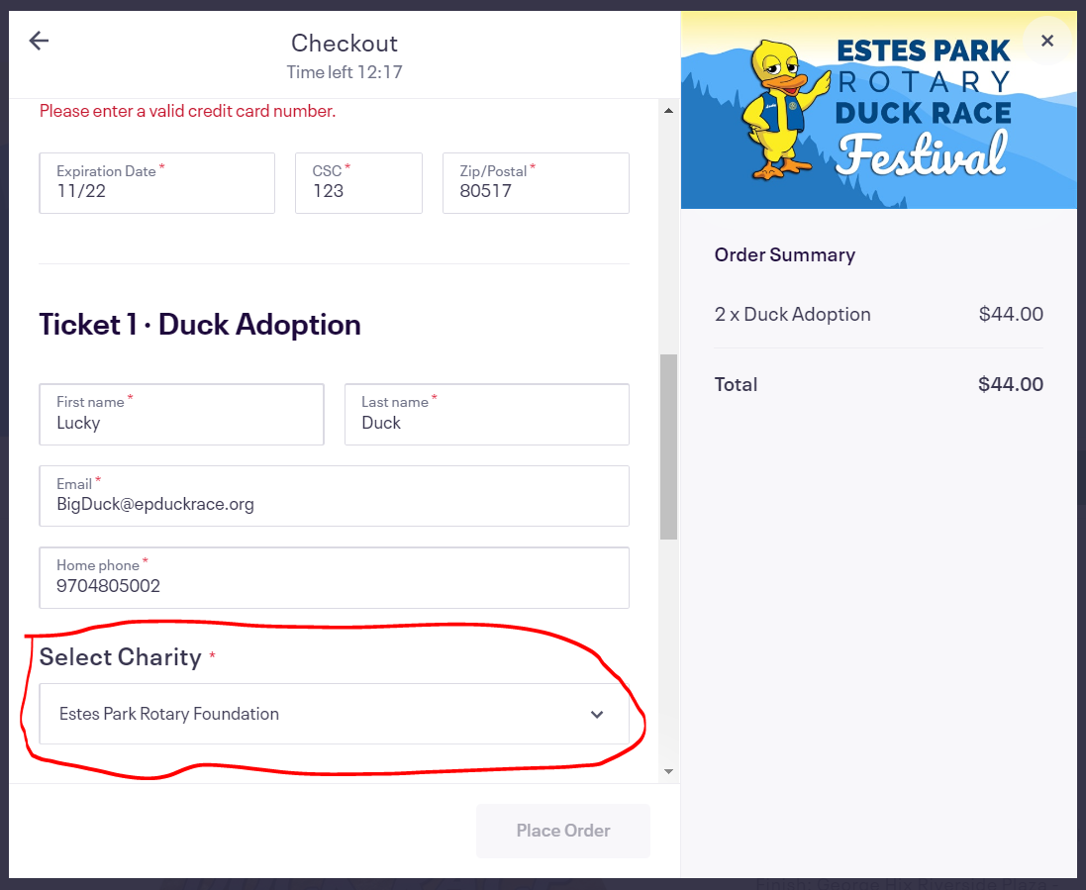

Slide 20
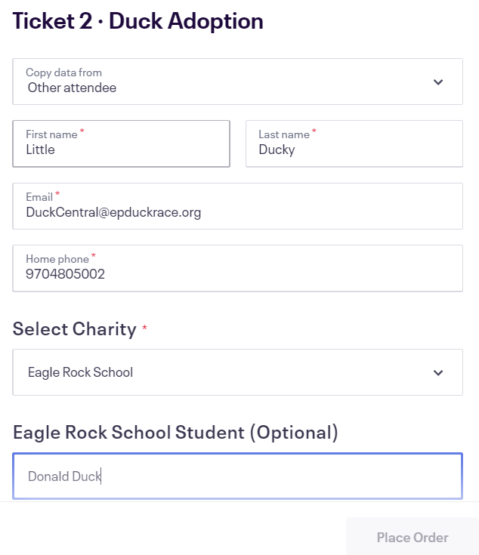

Slide 21
Custom FIELD QUESTIONs Do you need this?
Ballet Renaissance Student (Optional)
Center Stage School of Dance Student (Optional)
Eagle Rock School Student (Optional)
EP High School Activities Student (Optional)
EP High School Choirs Student (Optional)
EP Junior Golf Student (Optional)
EP Middle School Choir Student (Optional)
EP Schools Bands Student (Optional)
Hub Student Ministries Student (Optional)
Ravencrest Chalet Student (Optional)

Slide 22
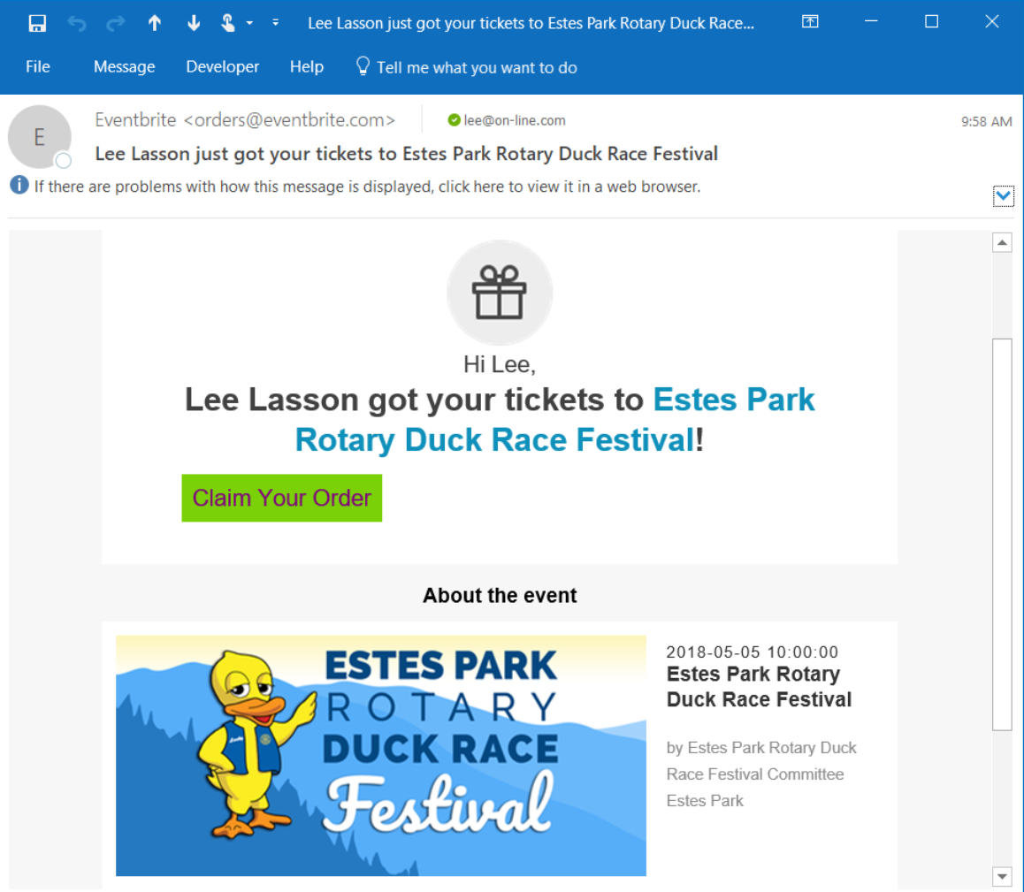

Slide 23
Sell in-person
Order using EPDuckRace.org
On an Apple iPhone or iPad with camera
On an Android Phone or Pad with camera
Camera can be used to enter the credit card number and expiration date. Much easier than trying to type 16 digits correctly! It is a feature on most cameras.
Simply hold the Credit Card up to the camera and it will auto fill card information.

Slide 24
Lucky Duck appearance
Zoom appearance – keep in mind that Lucky doesn’t talk
Duck-in appearance
Request by calling or texting Lucky Duck’s agent
Karen Thompson (970) 590-9942

Slide 25
Questions?
Duck Central
DuckCentral@EPDuckRace.org
NEW: Duck Central phone
(970) 235-1721
Email or call to ask questions

